Slide 1
ECE 471/571 – Lecture 8
Dimensionality Reduction – Principal Component Analysis
09/15/14

Slide 2
Different Approaches - More Detail
Pattern Classification
Statistical Approach
Syntactic Approach
Supervised
Unsupervised
Basic concepts:
Baysian decision rule
(MPP, LR, Discri.)
Basic concepts:
Distance
Agglomerative method
Parametric learning (ML, BL)
k-means
Non-Parametric learning (kNN)
Winner-take-all
NN (Perceptron, BP)
Kohonen maps
Dimensionality Reduction
Fisher’s linear discriminant
K-L transform (PCA)
Performance Evaluation
ROC curve
TP, TN, FN, FP
Stochastic Methods
local optimization (GD)
global optimization (SA, GA)
ECE471/571, Hairong Qi

Slide 3
Principal Component Analysis or K-L Transform
How to find a new feature space (m-dimensional) that is adequate to describe the original feature space (d-dimensional). Suppose m<d
x2
y1
y2
x1

Slide 4
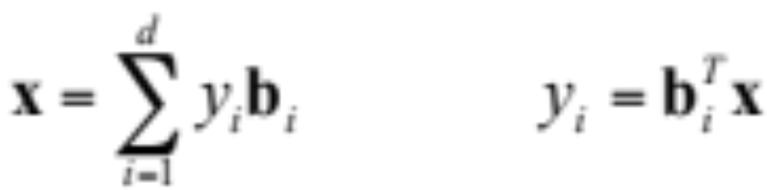
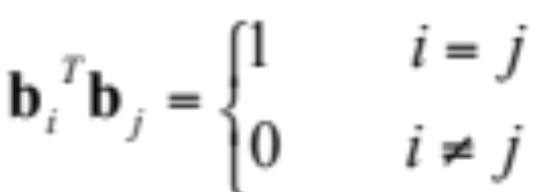
K-L Transform (1)
Describe vector x in terms of a set of basis vectors b_{i}.
The basis vectors (b_{i}) should be linearly independent and orthonormal, that is,

Slide 5
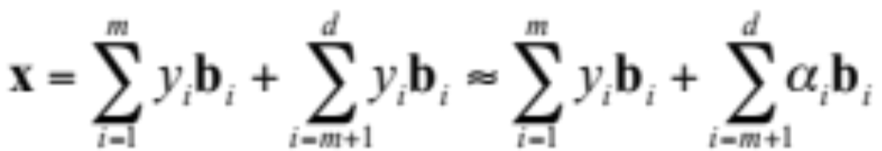
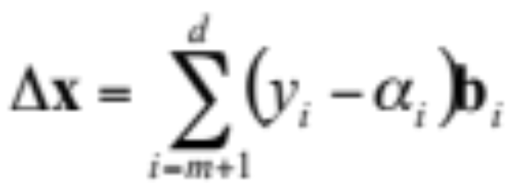
K-L Transform (2)
Suppose we wish to ignore all but m (m<d) components of y and still represent x, although with some error. We will thus calculate the first m elements of y and replace the others with constants
Error:

Slide 6
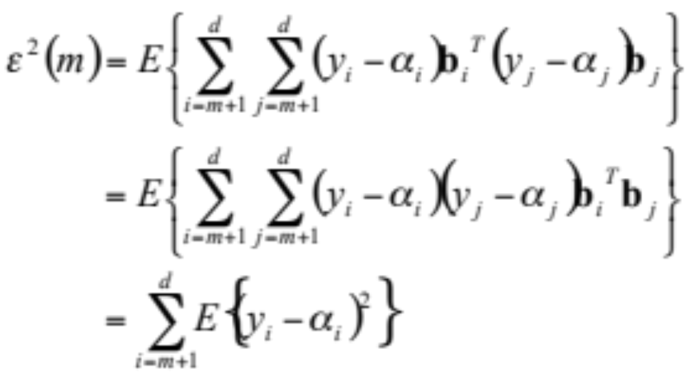
K-L Transform (3)
Use mean-square error to quantify the error

Slide 7
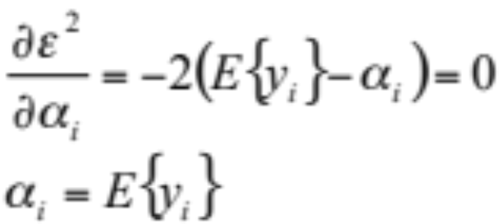
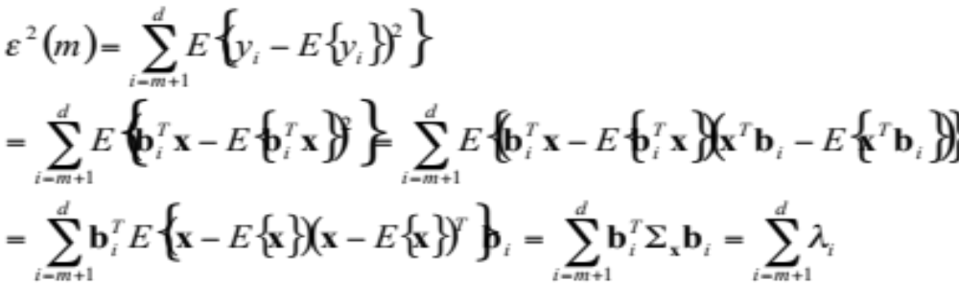
K-L Transform (4)
Find the optimal α_{i} to minimize ε²
Therefore, the error is now equal to

Slide 8
K-L Transform (5)
The optimal choice of basis vectors is the eigenvectors of Σ_{x}
The expansion of a random vector in terms of the eigenvectors of the covariance matrix is referred to as the Karhunen-Loeve expansion, or the “K-L expansion”
Without loss of generality, we will sort the eigenvectors b_{i} in terms of their eigenvalues. That is λ₁ >= λ₂ >= … >= λ_{d}. Then we refer to b₁, corresponding to λ₁, as the “major eigenvector”, or “principal component”

Slide 9
Summary
Raw data → covariance matrix → eigenvalue → eigenvector → principal component
How to use error rate?

